Slide 1


Landscape Metrics & Spatial Patterns Analysis
Felipe Martello
Milton Cezar Ribeiro

Slide 2
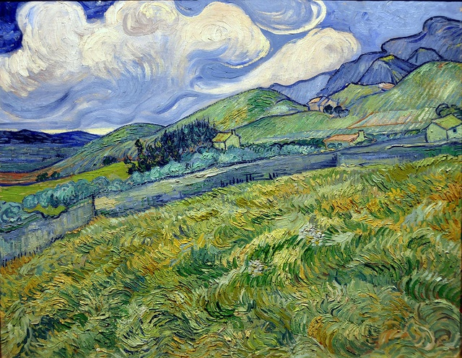
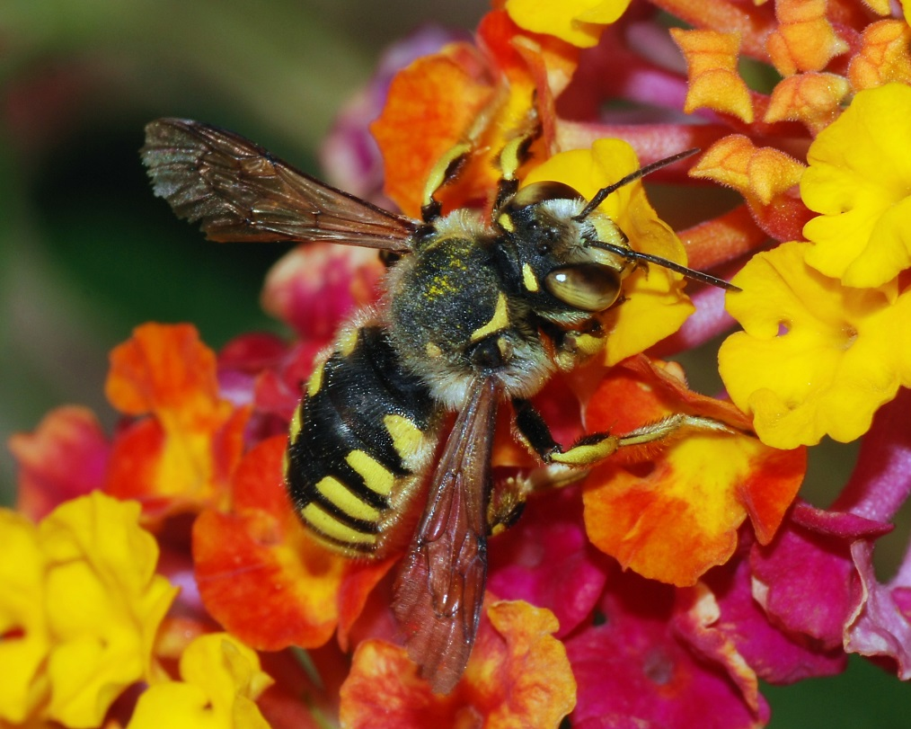
Landscape metrics and Spatial pattern analisys
Introduction
Landscape ecology is largely founded on the notion that spatial and environmental patterns strongly influence species distribution and ecological processes (Uemma et al. 2013).
Environmental patterns
Ecological process

Slide 3
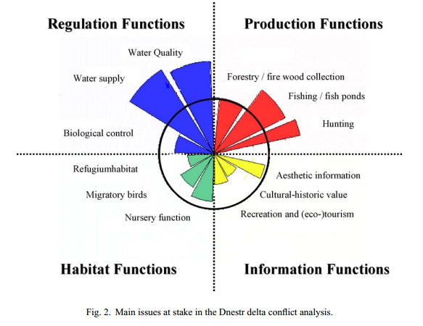
Landscape metrics and Spatial pattern analisys
Introduction
Usual landscape ecology question:
How does the spatial arrangement of habitat
influence the presence and abundance of species?
Does the landuse influence local
populations?
Do landscape patterns affect the transport of materials from land to water?
How can legacy of land use of a urban landscape affect the afforestation pattern?
De Groot 2006

Slide 4
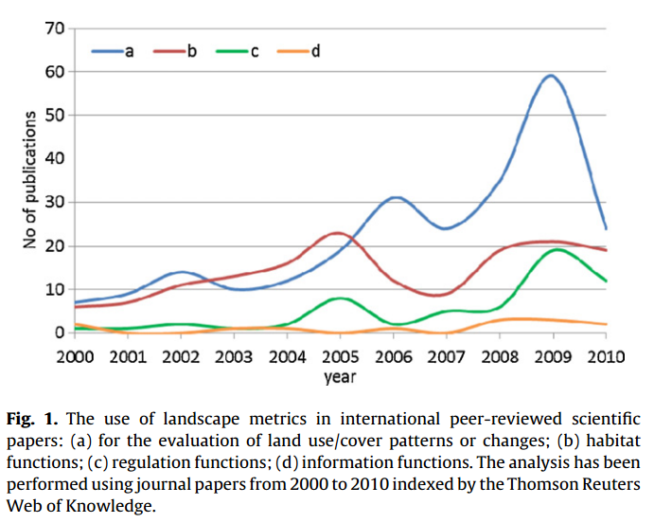
Landscape metrics and Spatial pattern analisys
Introduction
Quantification of landscape patterns is a prerequisite for the study of pattern–process relationships (McGarigal et al. 2002).
Landscape metrics are one of the most popular methods for the quantification of landscape patterns.
Uuemma et al. 2013

Slide 5
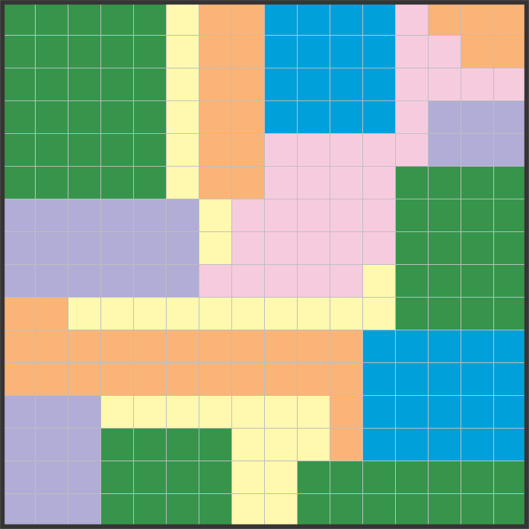
Landscape metrics and Spatial pattern analisys
Levels of Landscape metrics
How can we describe a landscape?

Slide 6
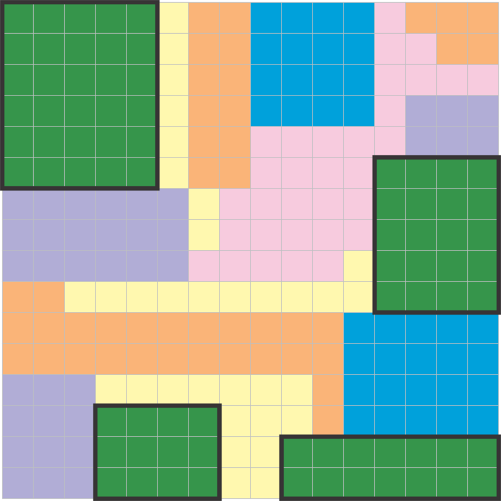
Landscape metrics and Spatial pattern analisys
Levels of Landscape metrics
How can we describe a landscape?
Landscape metrics can be calculated by:
Patches

Slide 7
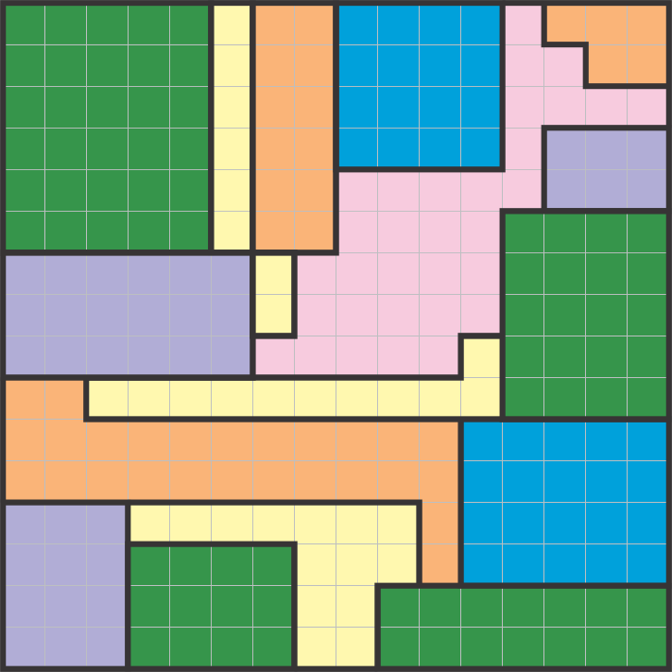
Landscape metrics and Spatial pattern analisys
Levels of Landscape metrics
How can we describe a landscape?
Landscape metrics can be calculated by:
Patches
Classes

Slide 8
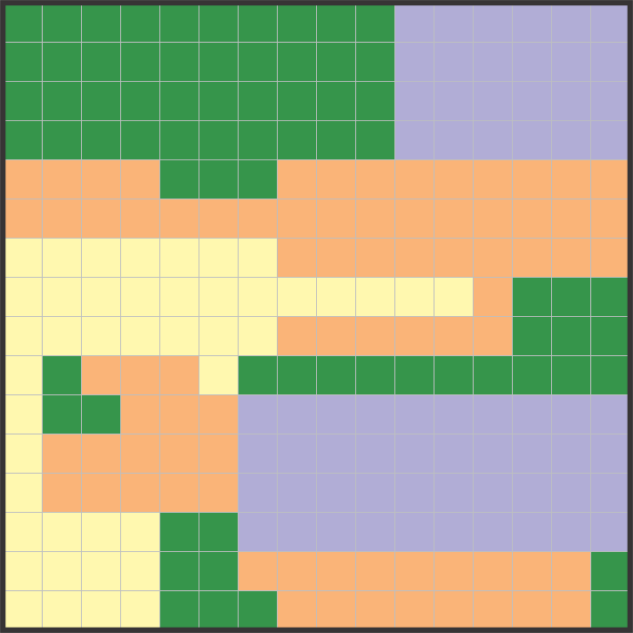
Landscape metrics and Spatial pattern analisys
Levels of Landscape metrics
How can we describe a landscape?
Landscape metrics can be calculated by:
Patches
Classes
Landscape

Slide 9
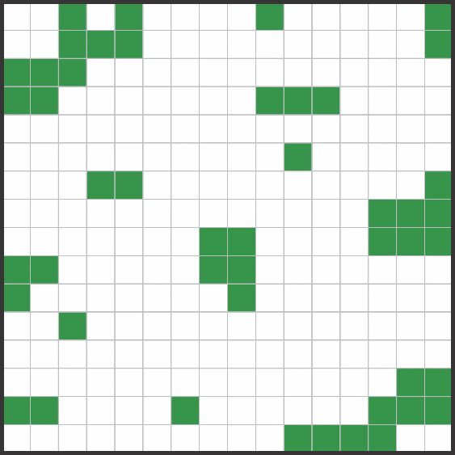
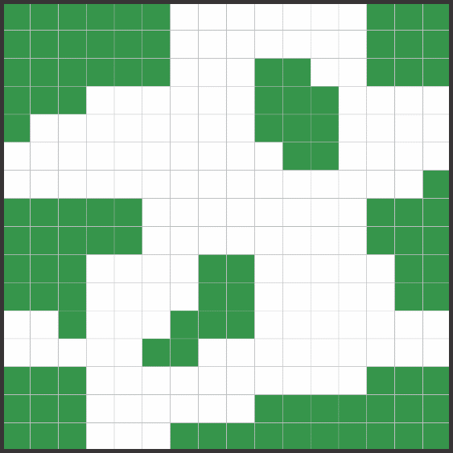
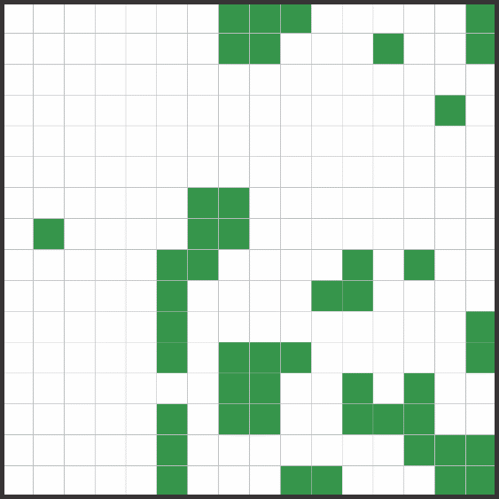
Landscape metrics and Spatial pattern analisys
Types of Landscape Metrics
Two types of landscape metrics:
Composition:
Quantification of landscape
What are the landscape elements?
How much of each landscape elements?
It does not take account the spatial arrangement.

Slide 10

Landscape metrics and Spatial pattern analisys
Composition Landscape Metrics
Patch metrics
Patch 1 Patch 2
Area
Perimeter

Slide 11

Landscape metrics and Spatial pattern analisys
Composition Landscape Metrics
Class metrics
Total area
Proportional area
Numbers of patches
Average area, perimeter, etc.

Slide 12
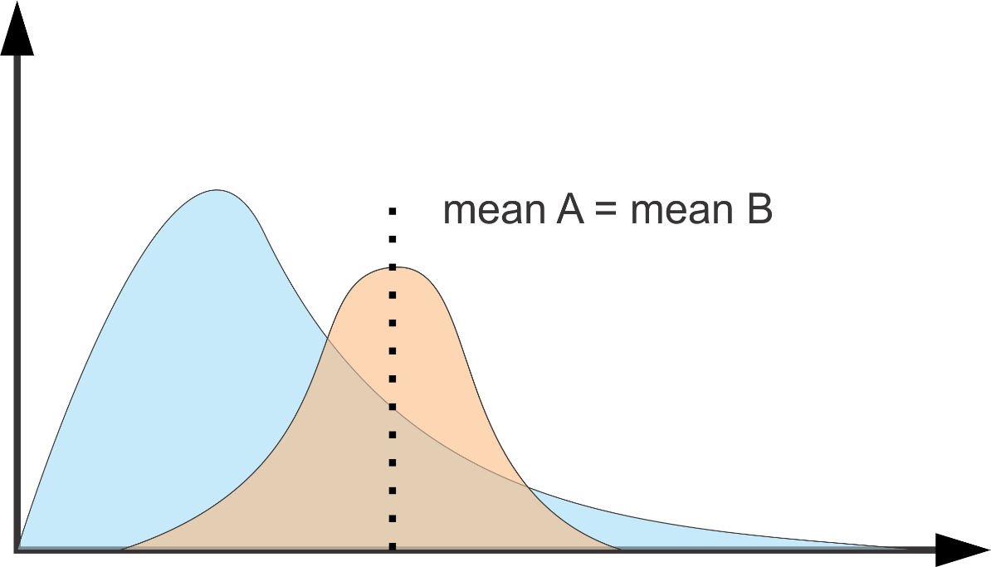
Landscape metrics and Spatial pattern analisys
Composition Landscape Metrics
Class metrics
Total area
Proportional area
Numbers of patches
Average area, perimeter, etc.

Slide 13
Landscape metrics and Spatial pattern analisys
Composition Landscape Metrics
Class metrics
Total area
Proportional area
Numbers of patches
Average area, perimeter, etc.
Descriptive statistics: SD, CI, min value, max value, mode, median

Slide 14


Landscape metrics and Spatial pattern analisys
Composition Landscape Metrics
Landscape metrics
Total area
Diversity of classes (richness, Shannon, Simpson): heterogeneity
Largest patch
Descriptive statistics of others levels: mean, SD, CI, min value, max value, mode, median

Slide 15
Landscape metrics and Spatial pattern analisys
Composition Landscape Metrics
Which landscape has better condition?
A: 12 patches
B: 10 patches
C: 7 patches
D: 5 patches

Slide 16
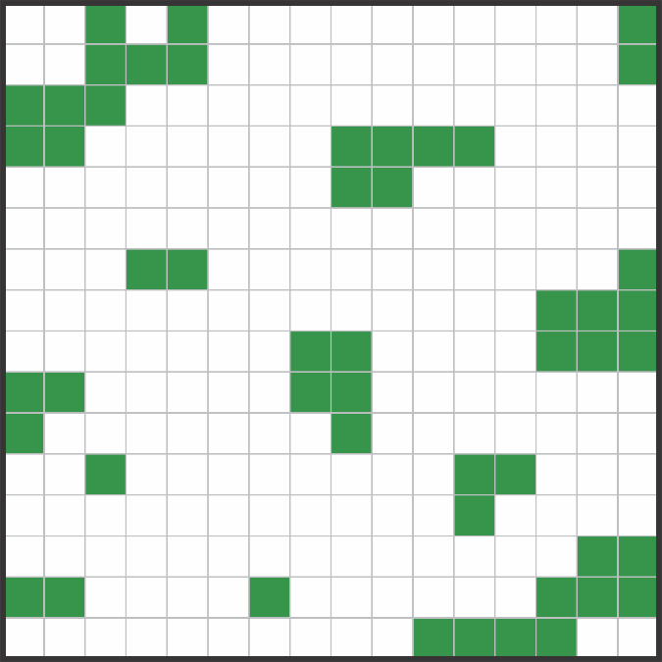
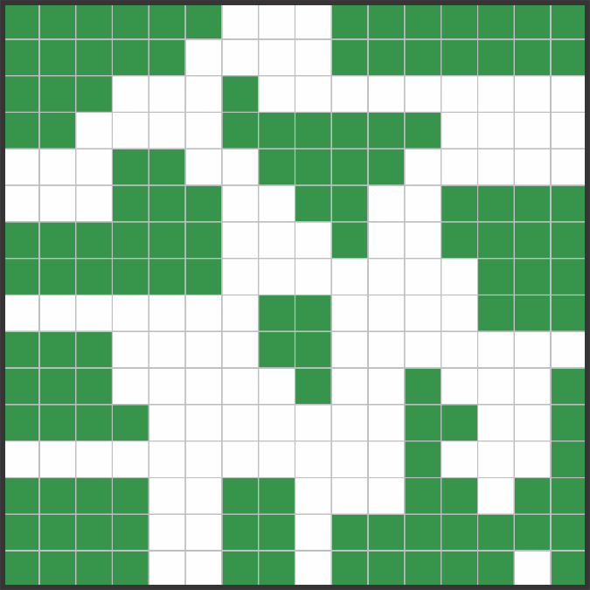
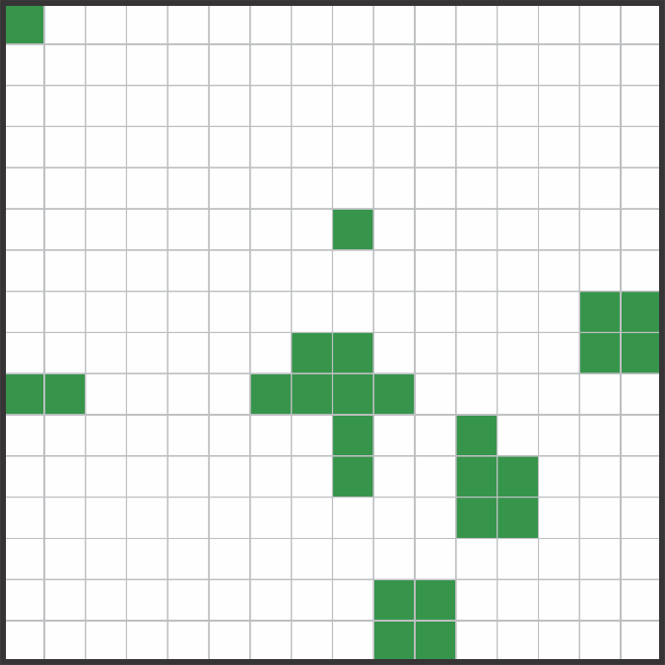
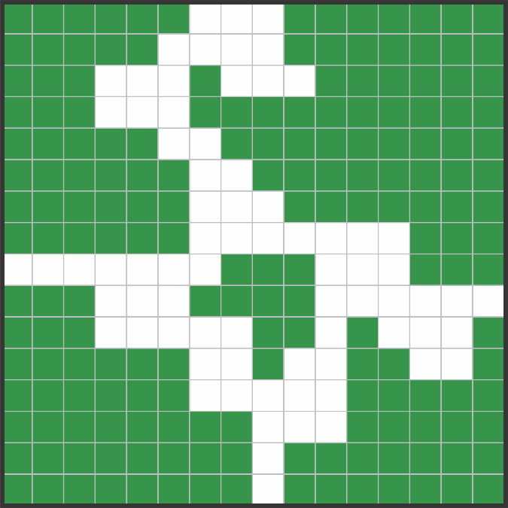
Landscape metrics and Spatial pattern analisys
Composition Landscape Metrics
A
B
Which landscape has better condition?
A: 12 patches
B: 10 patches
C: 7 patches
D: 5 patches
C
D
What information was missing?

Slide 17
Landscape metrics and Spatial pattern analisys
Composition Landscape Metrics
A
B
Which landscape has better condition?
A: 12 patches
B: 10 patches
C: 7 patches
D: 5 patches
C
D
What information was missing?
Habitat area
Mean of patches area

Slide 18
Landscape metrics and Spatial pattern analisys
Composition Landscape Metrics
Which landscape has better condition?
A: -patches: 26
-total habitat: 86 pixels
B: -patches: 5
-total habitat: 79 pixels

Slide 19
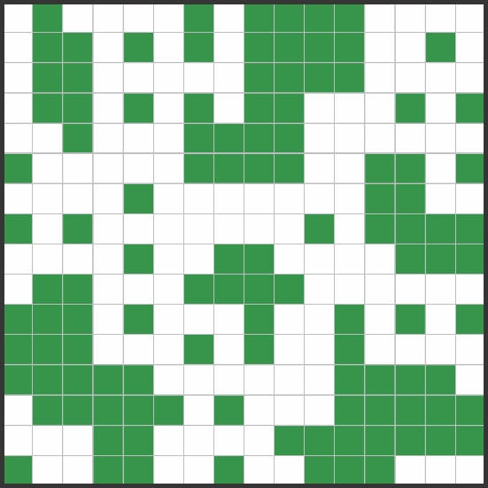
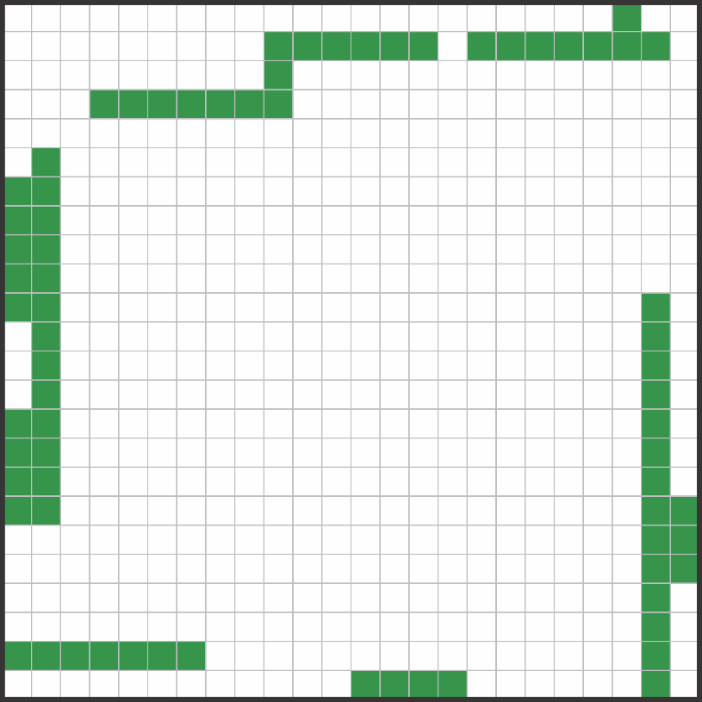
Landscape metrics and Spatial pattern analisys
Composition Landscape Metrics
A
Which landscape has better condition?
A: -patches: 26
-total habitat: 86 pixels
B: -patches: 5
-total habitat: 79 pixels
B
What information was missing?

Slide 20
Landscape metrics and Spatial pattern analisys
Composition Landscape Metrics
A
Which landscape has better condition?
A: -patches: 26
-total habitat: 86 pixels
B: -patches: 5
-total habitat: 79 pixels
B
What information was missing?
Total area
Density of patches (patches/ha)
Which landscape is larger?

Slide 21
Landscape metrics and Spatial pattern analisys
Composition Landscape Metrics
A
Considerations:
Composition Landscape Metrics, when analyzed individually, may
suggest misinterpretation.
Carefully consider the relevant perspective
Area-weighted mean metric: mean (metric *a/A)
B
These metrics relevates the proportion of represented area of the element
Examine the landscape metric distribution

Slide 22
Landscape metrics and Spatial pattern analisys
Types of Landscape Metrics
Two types of landscape metrics:
Composition
Configuration:
Spatial arrangement of the elements
How landscape elements are spatially?

Slide 23
Landscape metrics and Spatial pattern analisys
Configuration Landscape Metrics
Shape complexity
Patch 1 Patch 2
Area Pacth 1 = Area Patch 2

Slide 24
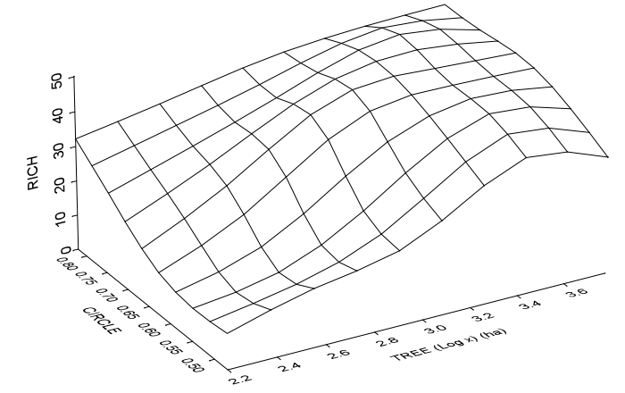
Landscape metrics and Spatial pattern analisys
Configuration Landscape Metrics
Shape complexity
Patch 1 Patch 2
Area
Perimeter
Perimeter/Area
Circle (CIRC)
Radius of gyration (GYRATE)
Radford et al. 2005

Slide 25
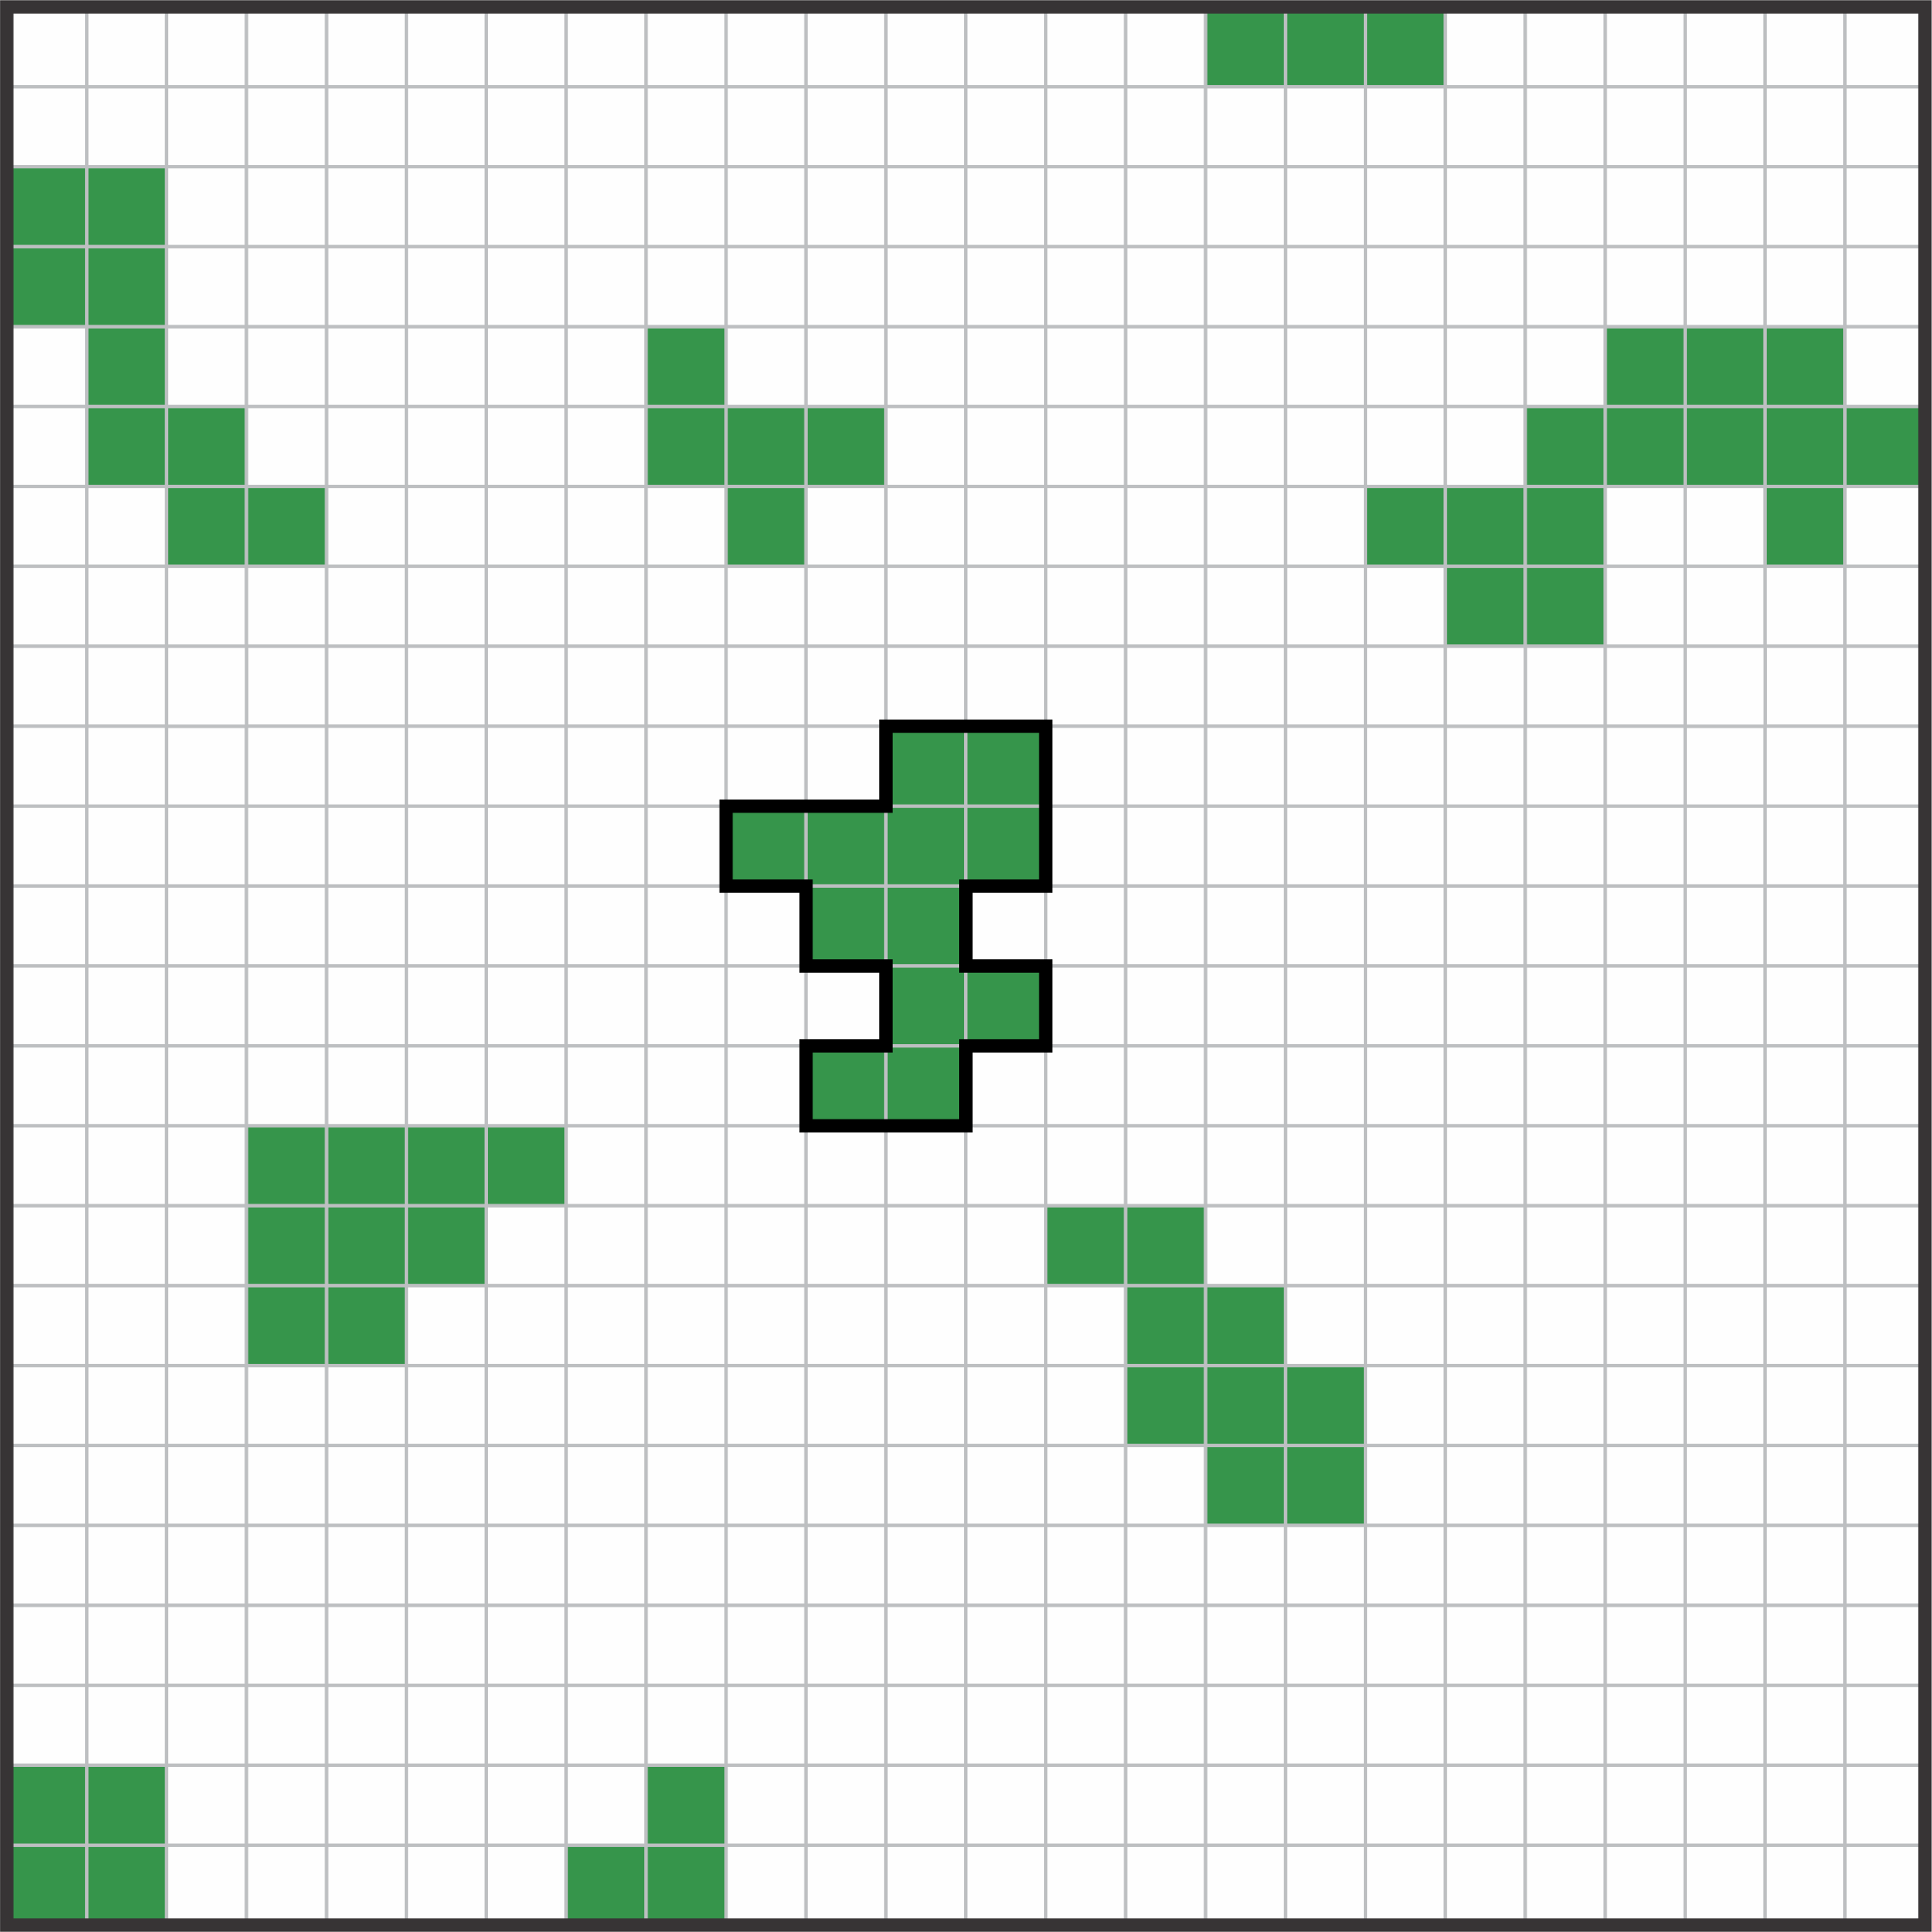
Landscape metrics and Spatial pattern analisys
Configuration Landscape Metrics
Isolation metrics: how far/close is an element of another?

Slide 26
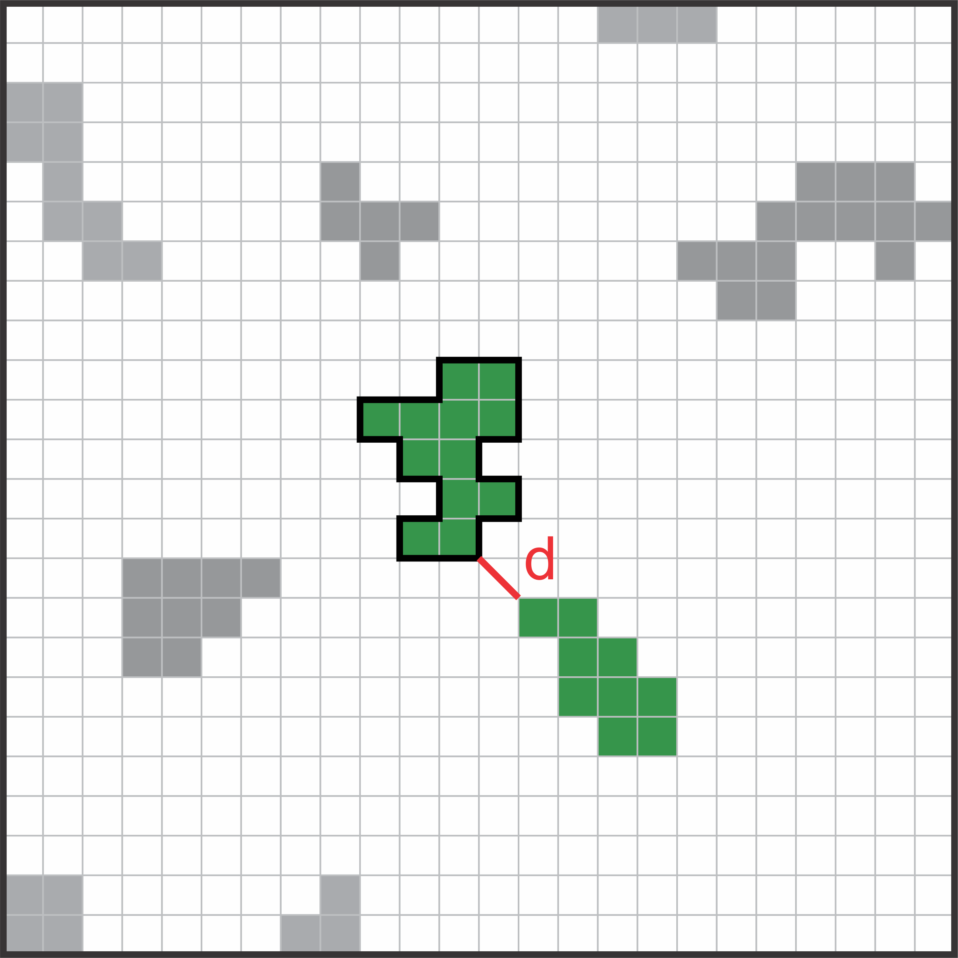
Landscape metrics and Spatial pattern analisys
Configuration Landscape Metrics
Isolation metrics: how far/close is an element of another?
Euclidinean nearest neighbor distance

Slide 27
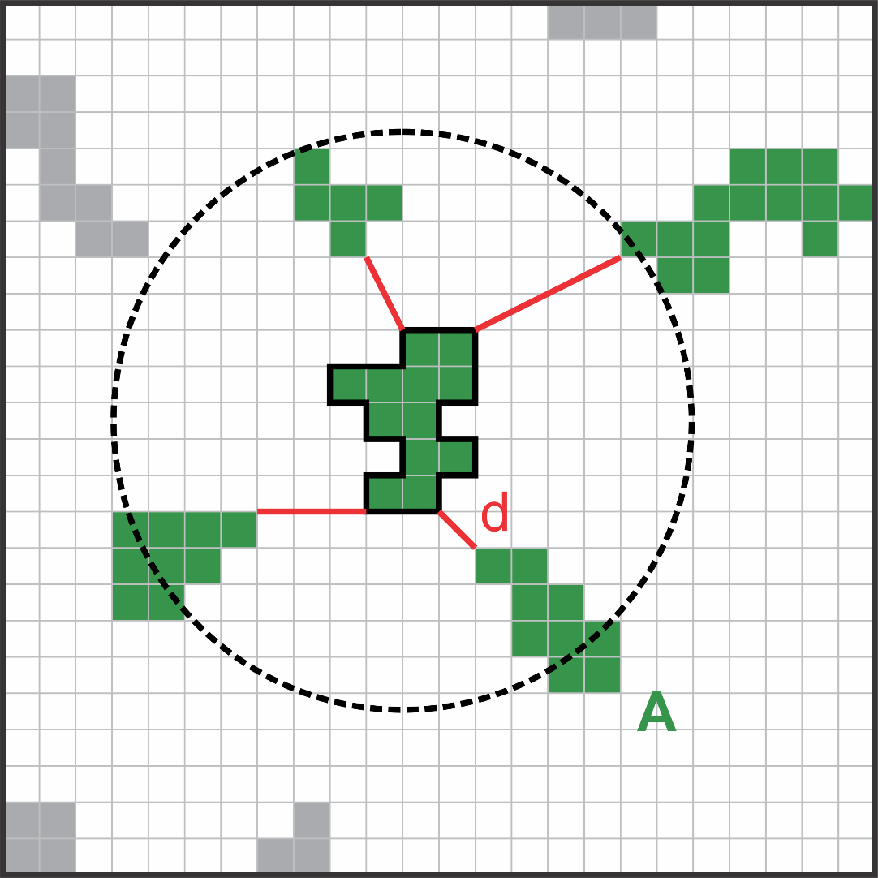
Landscape metrics and Spatial pattern analisys
Configuration Landscape Metrics
Isolation metrics: how far/close is an element of another?
Euclidinean nearest neighbor distance
Proximity index (PROX)*: Σ A/d²

Slide 28
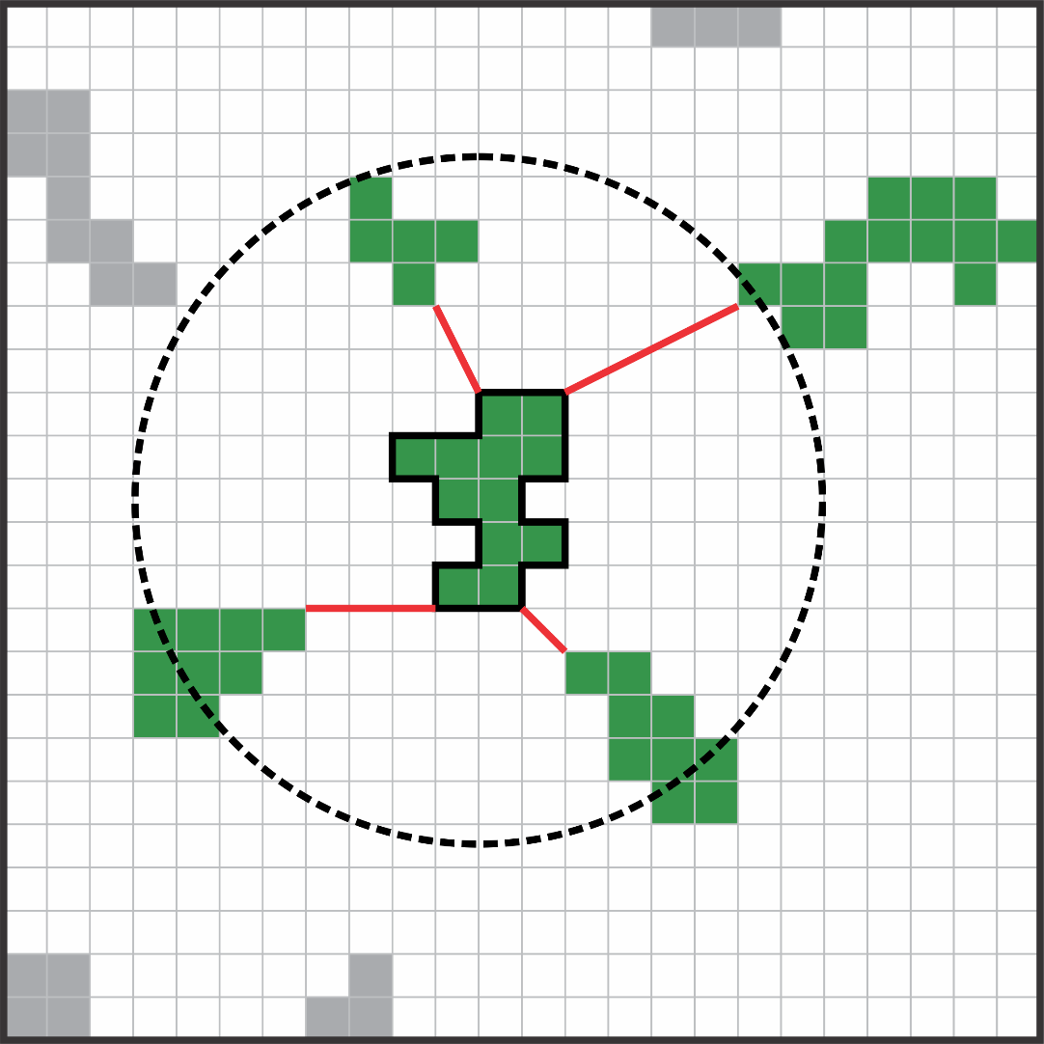
Landscape metrics and Spatial pattern analisys
Configuration Landscape Metrics
Isolation metrics: how far/close is an patch of another?
Euclidinean nearest neighbor distance
Proximity index (PROX)*: Σ A/d²
Connectance (CONNECT)*

Slide 29
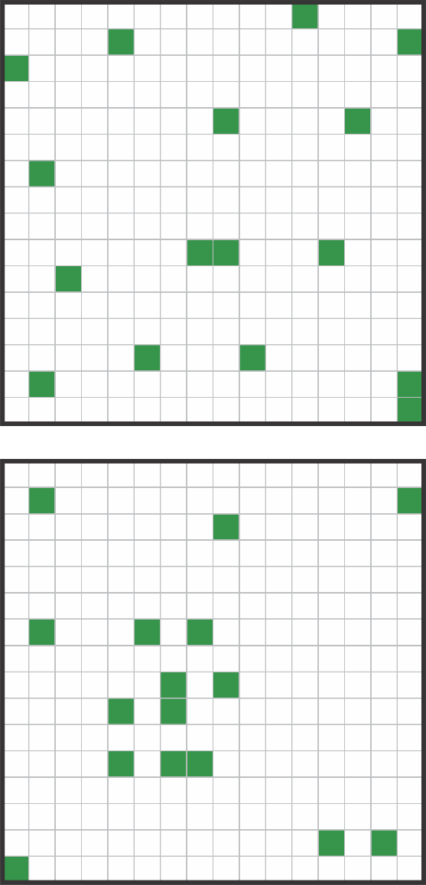
Landscape metrics and Spatial pattern analisys
Configuration Landscape Metrics
Dispersion and interspersed metrics: What is the degree of dispersion a class?
Clumpliness: In which regularity are patches distributed? (variation coefficient of a metric)
In each landscape do we have high clumpiness?

Slide 30
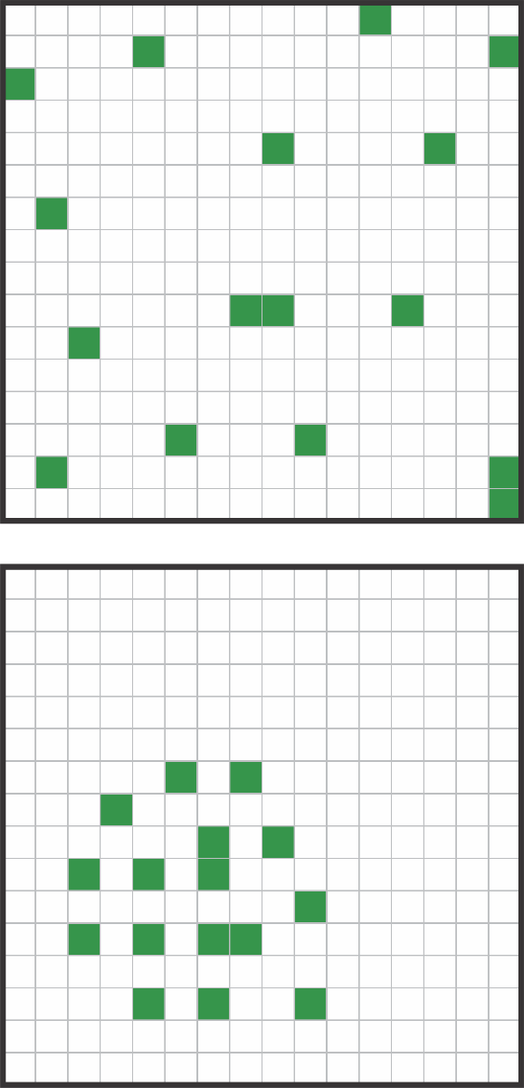
Landscape metrics and Spatial pattern analisys
Configuration Landscape Metrics
Dispersion and interspersed metrics: What is the degree of dispersion a class?
Clumpliness: In which regularity are patches distributed? (variation coefficient of a metric)
Contagium (CONTAG): Does cells of the same kind tend to be more clustered?
(1) the probability that a randomly chosen cell belongs to patch type i,
(2) the conditional probability that given a cell is of patch type i, one of its neighboring cells belongs to patch type j

Slide 31
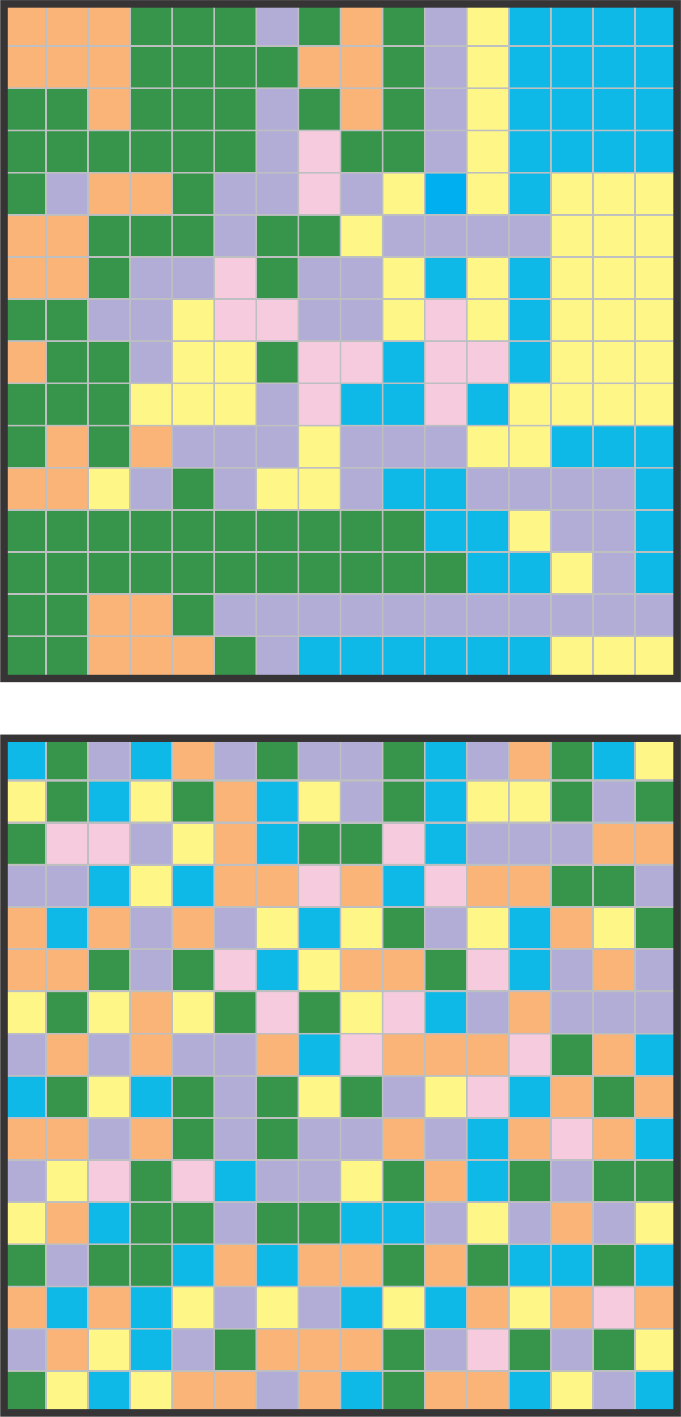
Landscape metrics and Spatial pattern analisys
Configuration Landscape Metrics
Dispersion and interspersed metrics: What is the degree of dispersion a class?
Clumpliness: In which regularity are patches distributed? (variation coefficient of a metric)
Contagium: Does elements of the same kind tend to be more clustered?
Interpersion: how often each patch type is adjacent to each other patch type?

Slide 32
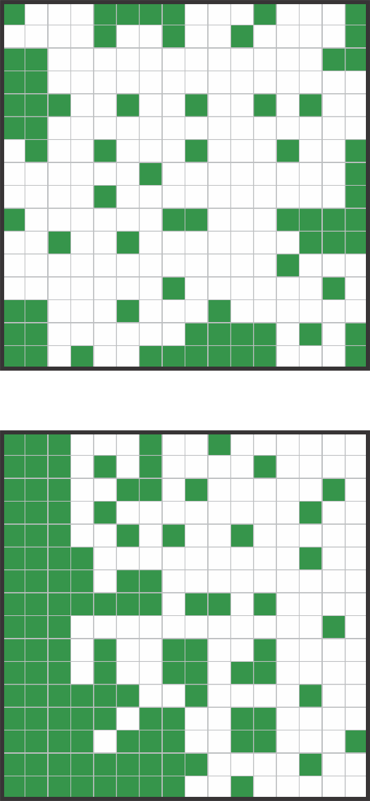
Landscape metrics and Spatial pattern analisys
Configuration Landscape Metrics
Dispersion and interspersed metrics: What is the degree of dispersion a class?
Clumpliness: In which regularity are patches distributed? (variation coefficient of a metric)
Contagium: Does elements of the same type tend to be more clustered?
Interpersion: how often each patch type is adjacent to each other patch type?
Anisotropy: Does the distribution pattern of a class follow a direction?

Slide 33
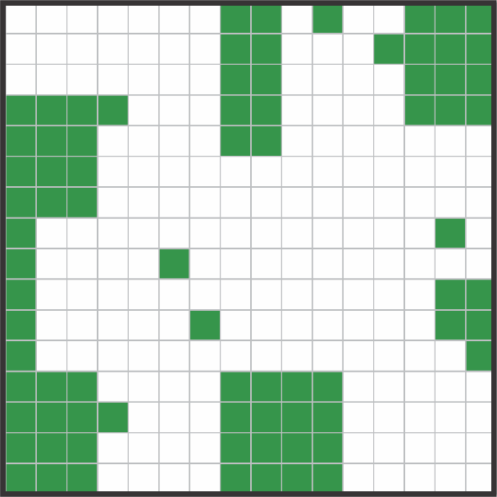
Landscape metrics and Spatial pattern analisys
Configuration Landscape Metrics
Conectivity: “Degree to which the landscape facilitates or impedes species movement”

Slide 34
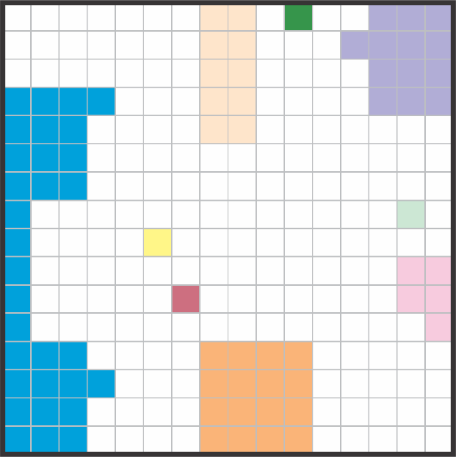
Landscape metrics and Spatial pattern analisys
Configuration Landscape Metrics
Conectivity: “Degree to which the landscape facilitates or impedes species movement”
Structural connectivity: Physical connection between patches

Slide 35
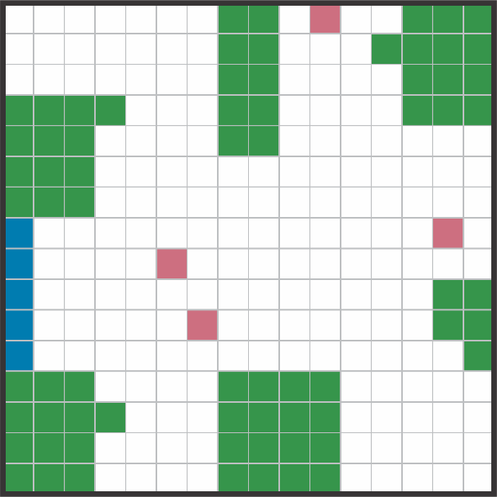
Landscape metrics and Spatial pattern analisys
Configuration Landscape Metrics
Conectivity: “Degree to which the landscape facilitates or impedes species movement”
Structural connectivity: Physical connection between patches
Need to establish criteria for categorizing landscape structures: habitat, matrix, corridors and steppingstones.

Slide 36
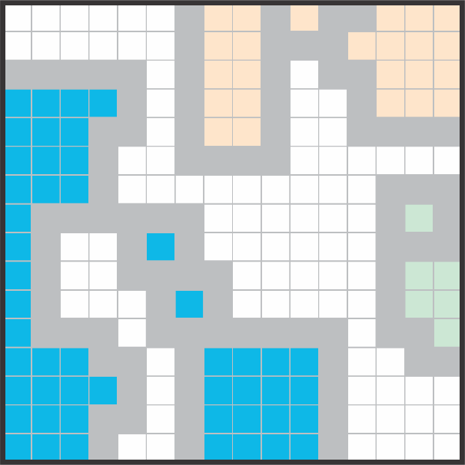
Landscape metrics and Spatial pattern analisys
Configuration Landscape Metrics
Conectivity: “Degree to which the landscape facilitates or impedes species movement”
Structural connectivity: Physical connection between patches
Functional connectivity: How patches are connected for a species?

Slide 37
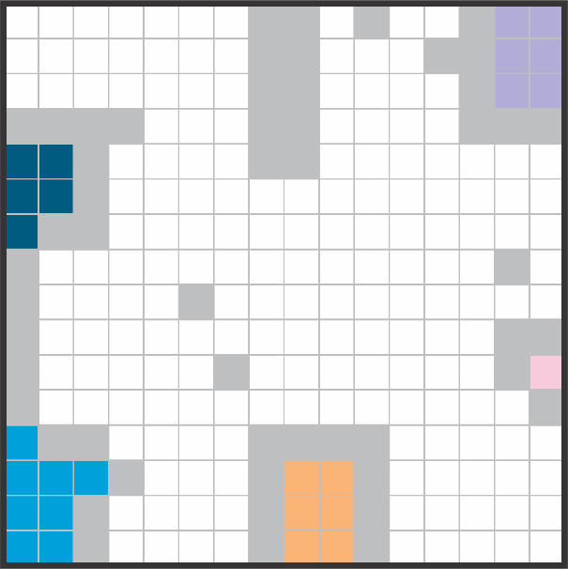
Landscape metrics and Spatial pattern analisys
Configuration Landscape Metrics
Conectivity: “Degree to which the landscape facilitates or impedes species movement”
Structural connectivity: Physical connection between patches
Functional connectivity: How patches are connected for a species?
Edge/Core area: How species really use habitat area?

Slide 38

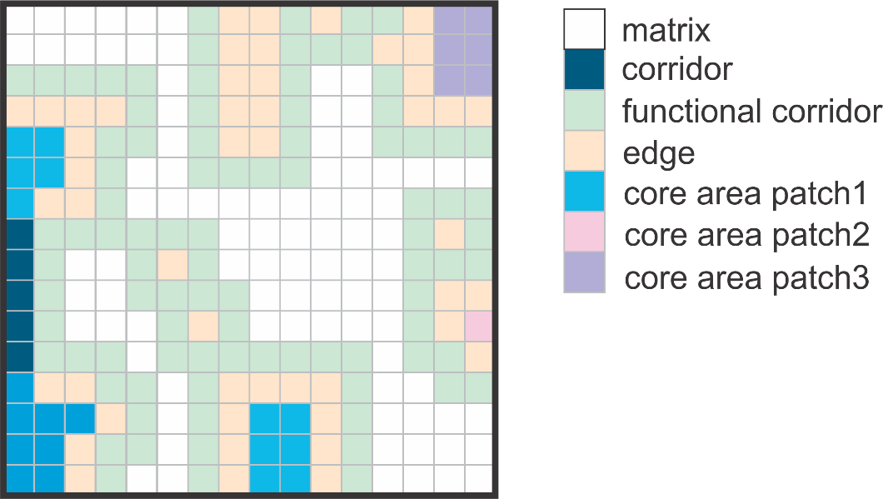
Landscape metrics and Spatial pattern analisys
Configuration Landscape Metrics
Can we a have a situation like this?

Slide 39
Landscape metrics and Spatial pattern analisys
Configuration Landscape Metrics
Can we a have a situation like this?
Functional x structural corridors
Edge x functional corridors
Functional connectivity x Suitable habitat

Slide 40
Landscape metrics and Spatial pattern analisys
Configuration Landscape Metrics
Considerations
There are several ways to calculate a particular metric: you must compare among all which best fits your questions.
Most of configuration metrics need a biological information: you must know well the biological/ecological history of the species.

Slide 41
Landscape metrics and Spatial pattern analisys
Continuous Landscape Metrics
Each pixel is associated with neighboring pixels
Generates a map as metric
Most used continuous metric:
Euclidian distance
Moving window
Kernel

Slide 42
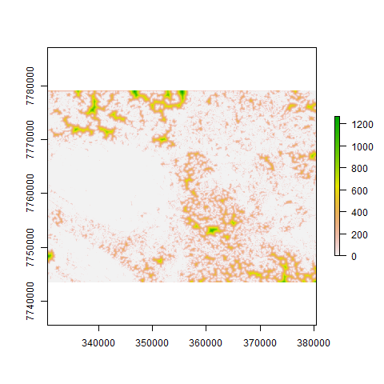
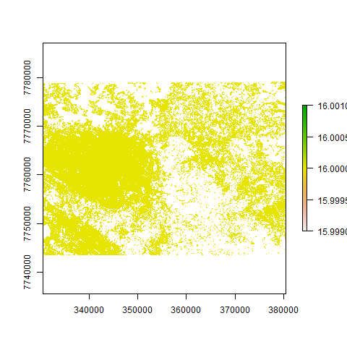
Landscape metrics and Spatial pattern analisys
Continuous Landscape Metrics
Euclidian distance algorithm: how far each pixel is from some class?
Map of euclidian distance from habitat
Binary map of habitat

Slide 43
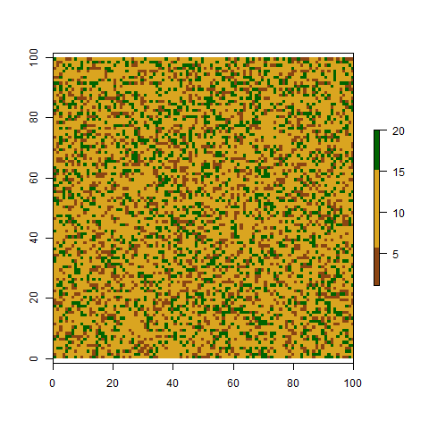
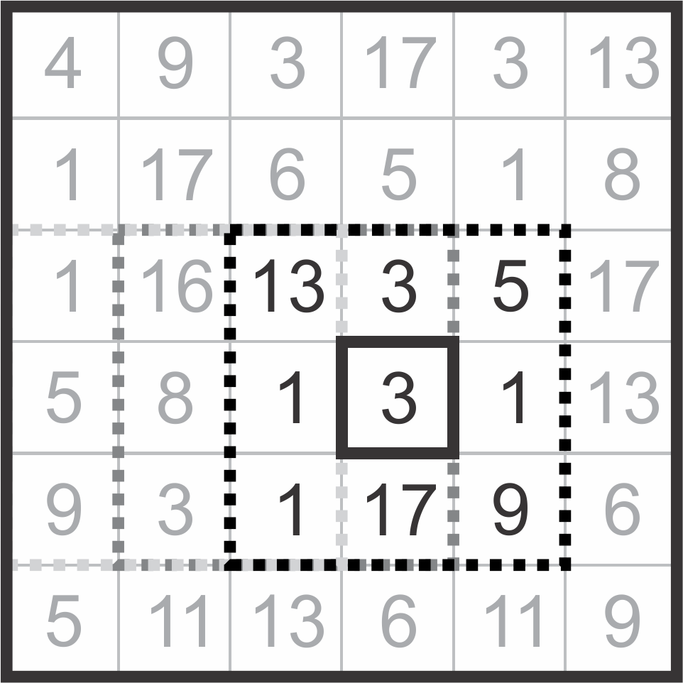
Landscape metrics and Spatial pattern analisys
Continuous Landscape Metrics
Moving window: returns a value to each pixel based on the values ​​of neighboring pixels?
3x3 moving window
Land use map
Mean:(13+3+5+1+3+1+1+17+9)/9 = 5.88

Slide 44
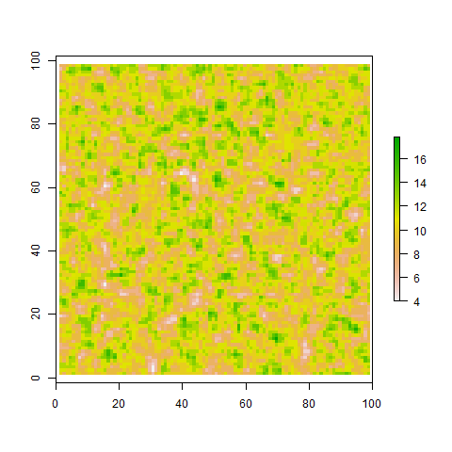
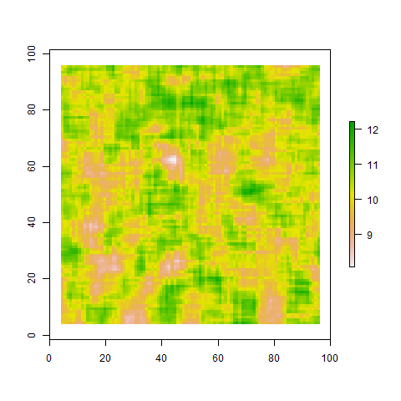
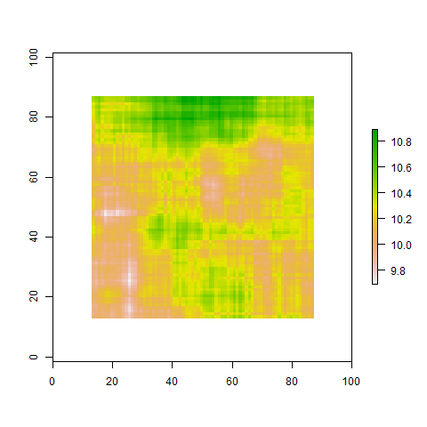
Landscape metrics and Spatial pattern analisys
Continuous Landscape Metrics
Moving window
Decision 1: window size
Land use map
Moving 3x3
How to choose the window size?
Moving 9x9
Moving 27x27

Slide 45
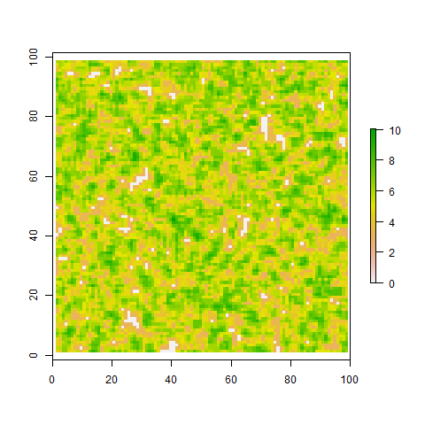
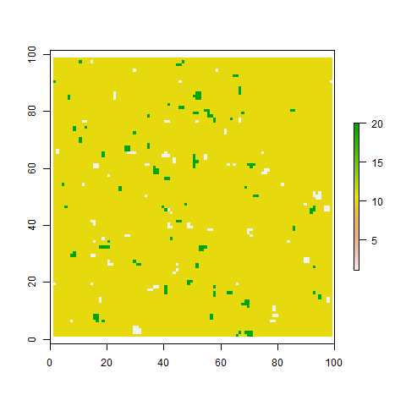
Landscape metrics and Spatial pattern analisys
Continuous Landscape Metrics
Considerations
Land use map
Decision 2: function
Moving 3x3 - mean
Which function to use?
Mean
Mode
Median
SD
Minimum value
Maximun value
Moving 3x3 - sd
Moving 3x3 - median

Slide 46
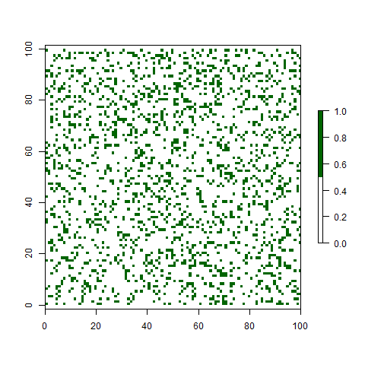
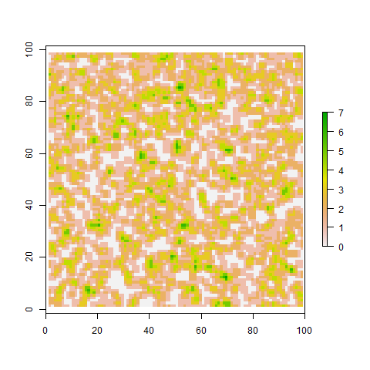
Landscape metrics and Spatial pattern analisys
Continuous Landscape Metrics
Consideretaions
Decision 3: input map
Land use map
Land moving 3x3 - mean
What is the input information?
Land use
Variable (e.g. temperature)
Binary map
Binary habitat map
Bin. moving 3x3 - mean

Slide 47
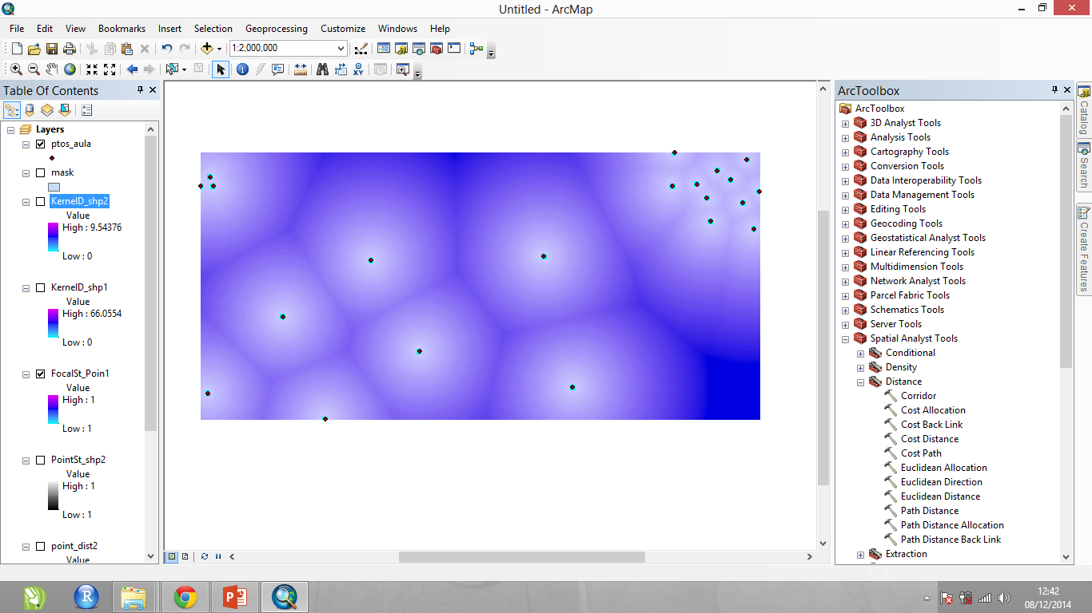
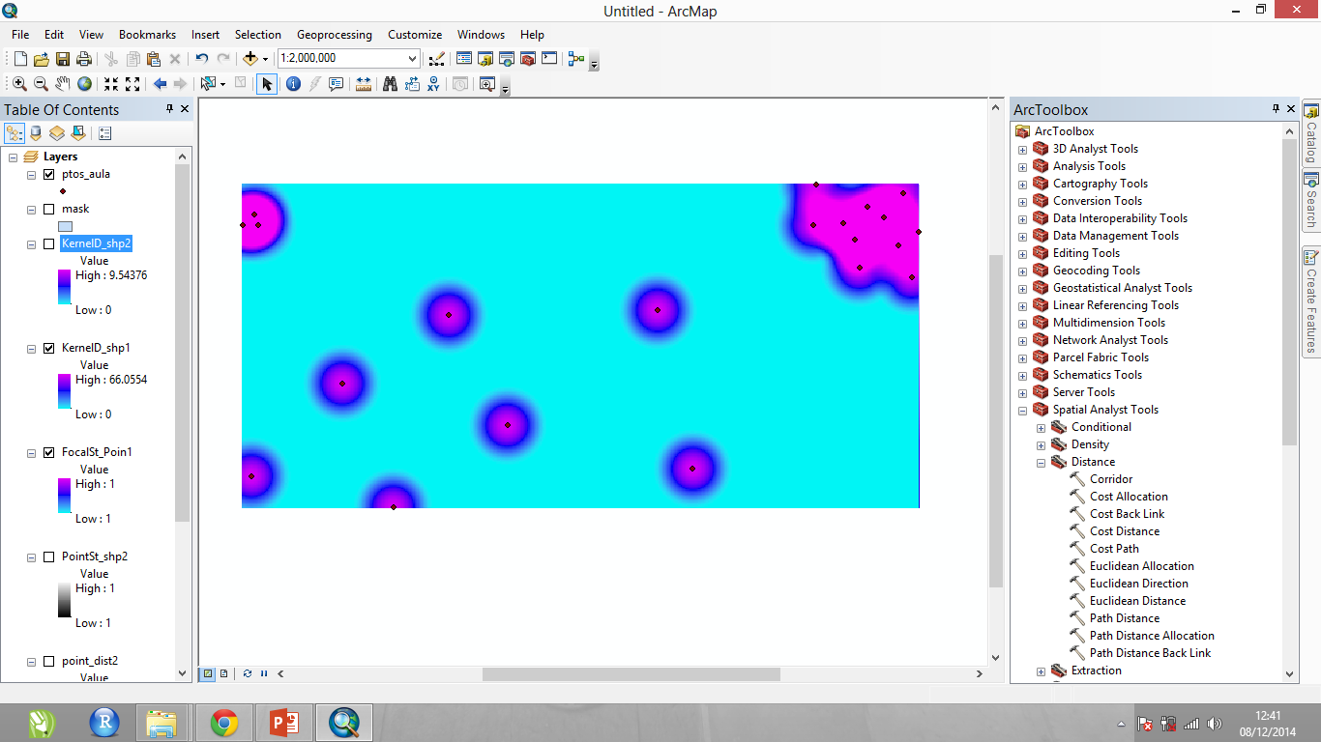
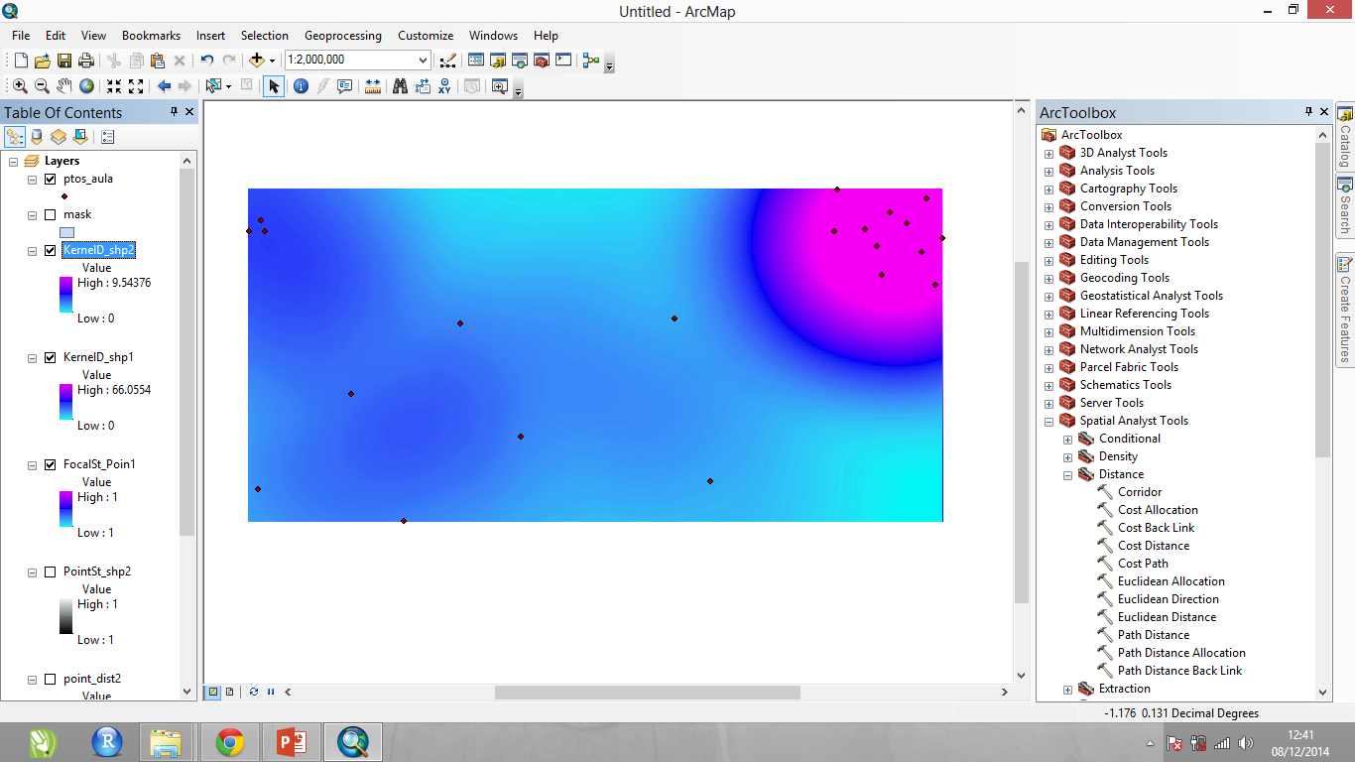
Landscape metrics and Spatial pattern analisys
Continuous Landscape Metrics
Euclidian distance
Considerations
Importance of biological decisions:
Euclidian: class
Moving: distance, function and input information
Kernel 10m
Kernel 100m

Slide 48
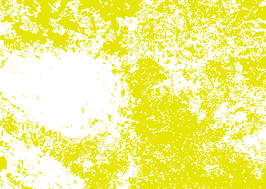
Landscape metrics and Spatial pattern analisys
Continuous Landscape Metrics
Considerations
How can we create a map of distance from edge?
Importance of biological decision
Binary map of matrix
Binary map of habitat
Composed explicit metrics

Slide 49
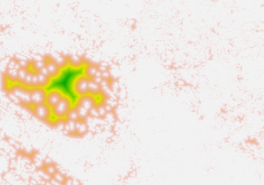
Landscape metrics and Spatial pattern analisys
Continuous Landscape Metrics
Considerations
How can we create a map of distance from edge?
Importance of biological decision
Binary map of matrix
Binary map of habitat
Composed explicit metrics
Distance from matrix
Distance from habitat

Slide 50
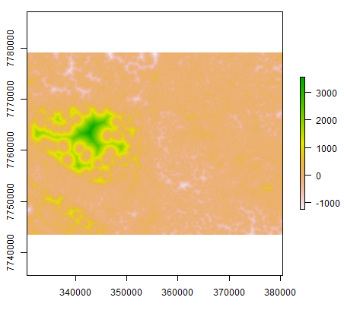
Landscape metrics and Spatial pattern analisys
Continuous Landscape Metrics
Considerations
How can we create a map of distance from edge?
Importance of biological decision
Binary map of matrix
Binary map of habitat
Distance from matrix
Distance from habitat
Composed explicit metrics
Distance from edge

Slide 51


Landscape metrics and Spatial pattern analisys
Continuous Landscape Metrics
Selecting areas with variations in:
Tree cover
Herbaceous cover
Street density
Considerations
Importance of biological decision
João Pena
(UFMG Phd student)
Composed explicit metrics
Helping experimental design

Slide 52



Landscape metrics and Spatial pattern analisys
Continuous Landscape Metrics
Selecting areas with variations in 3 variables
Tree cover
Moving window
Herbaceous cover
Moving window
Street density
Moving window
João Pena
(UFMG Phd student)
Categorization of values in 4 classes

Slide 53


Landscape metrics and Spatial pattern analisys
Continuous Landscape Metrics
Selecting areas with variations in 3 variables
Street density (1-4)
João Pena
(UFMG Phd student)
Tree cover x10
(10-40)
Herbaceous cover x100
(100-400)
Σ

Slide 54
Landscape metrics and Spatial pattern analisys
Continuous Landscape Metrics
Oh yeah!!
Selecting areas with variations in 3 variables
Street density (1-4)
João Pena
(UFMG Phd student)
Tree cover x10
(10-40)
Herbaceous cover x100
(100-400)
Σ

Slide 55

Landscape metrics and Spatial pattern analisys
Continuous Landscape Metrics
Euclidian distance from sugar cane
Considerations
Importance of biological decision
Composed explicit metrics
Can help in experimental design
Average distance of sugarcane points
Some statistics metrics can be extracted from theses maps

Slide 56

Landscape metrics and Spatial pattern analisys
Continuous Landscape Metrics
Considerations
The use of these maps as variables in SDM should be used with caution due to the weight that cause in the model due to biased sampling

Slide 57
Landscape Metrics & Spatial Patterns Analysis
Felipe Martello
Milton Cezar Ribeiro

